Slide 1
Being the “New Creation” we are –– HOLINESS
Disastrous when ‘man’s theology’ tells those who are saved, not to strive to live righteously.
The Atonement
^{5:21} For our sake he made him to be sin who knew no sin, so that in him we might become the righteousness of God.
The cost of Salvation: In some way, God caused the Sinless One to BE Sin.
Justification
We sinned, but the sin of Jesus’ Disciples is transferred to Christ.
At Judgment, Verdict: Justified
Sanctification
“the righteousness of God” not meant to be merely: Theoretical; or Legal...... We truly become “Holy”
We have a part to play. We work with God to live righteously
Contrary to some preaching, Scripture never tells God’s people “Don’t strive to do good”
6:1…. we appeal to you not to receive the grace of God in vain.
5:¹⁷ Therefore, if anyone is in Christ, he is a new creation. The old has passed away; behold, the new has come.
Grace isn’t ‘once only’. God continues to forgive. We continue to repent and strive to do right
As a new creation, our desire is to live righteously.
The Living God (living in us) helps us to live righteously (fruit of Spirit) & motivates us (fear)
7 Since we have these promises, beloved, let us cleanse ourselves from every defilement of body and spirit, bringing holiness to completion in the fear of God.

Slide 2
2 Corinthians 6:14 – 7:1

Slide 3
¹⁴ Do not be unequally yoked with unbelievers. For what partnership has righteousness with lawlessness? Or what fellowship has light with darkness? ¹⁵ What accord has Christ with Belial? Or what portion does a believer share with an unbeliever? ¹⁶ What agreement has the temple of God with idols? For we are the temple of the living God; as God said,

Slide 4
“I will make my dwelling among them and walk among them,
and I will be their God,
and they shall be my people.
¹⁷ Therefore go out from their midst,
and be separate from them, says the Lord,
and touch no unclean thing;
then I will welcome you,
¹⁸ and I will be a father to you,
and you shall be sons and daughters to me,
says the Lord Almighty.”

Slide 5
7 Since we have these promises, beloved, let us cleanse ourselves from every defilement of body and spirit, bringing holiness to completion in the fear of God.

Slide 6
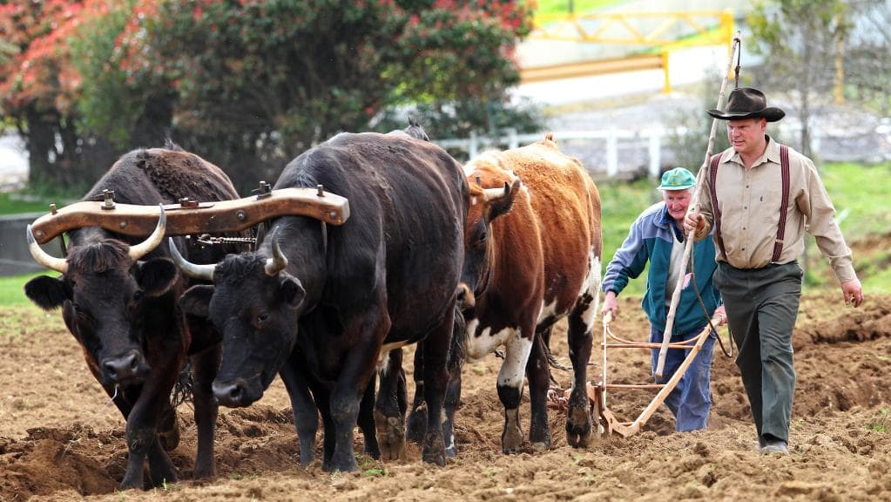

Slide 7
Being the “New Creation” we are –– HOLINESS
Do not be unequally yoked with unbelievers.... Be Separate.
“unequally yoked” isn’t about “size” or “maturity”. It’s harnessing 2 different species together.

Slide 8
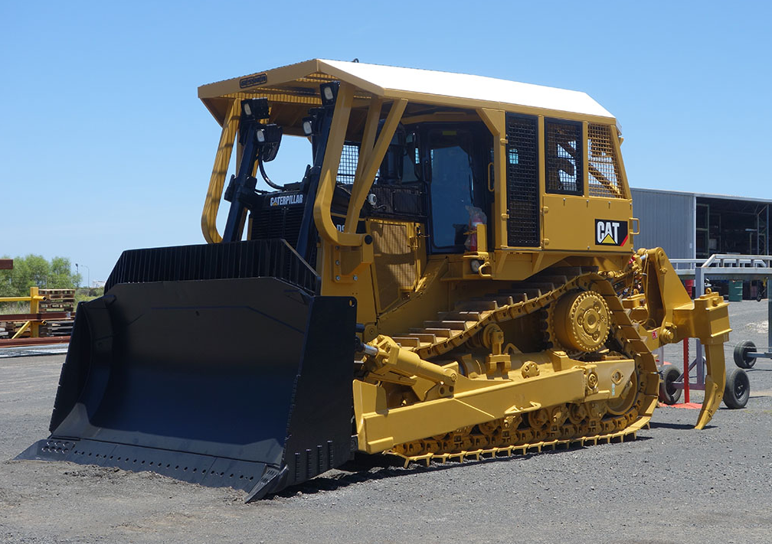
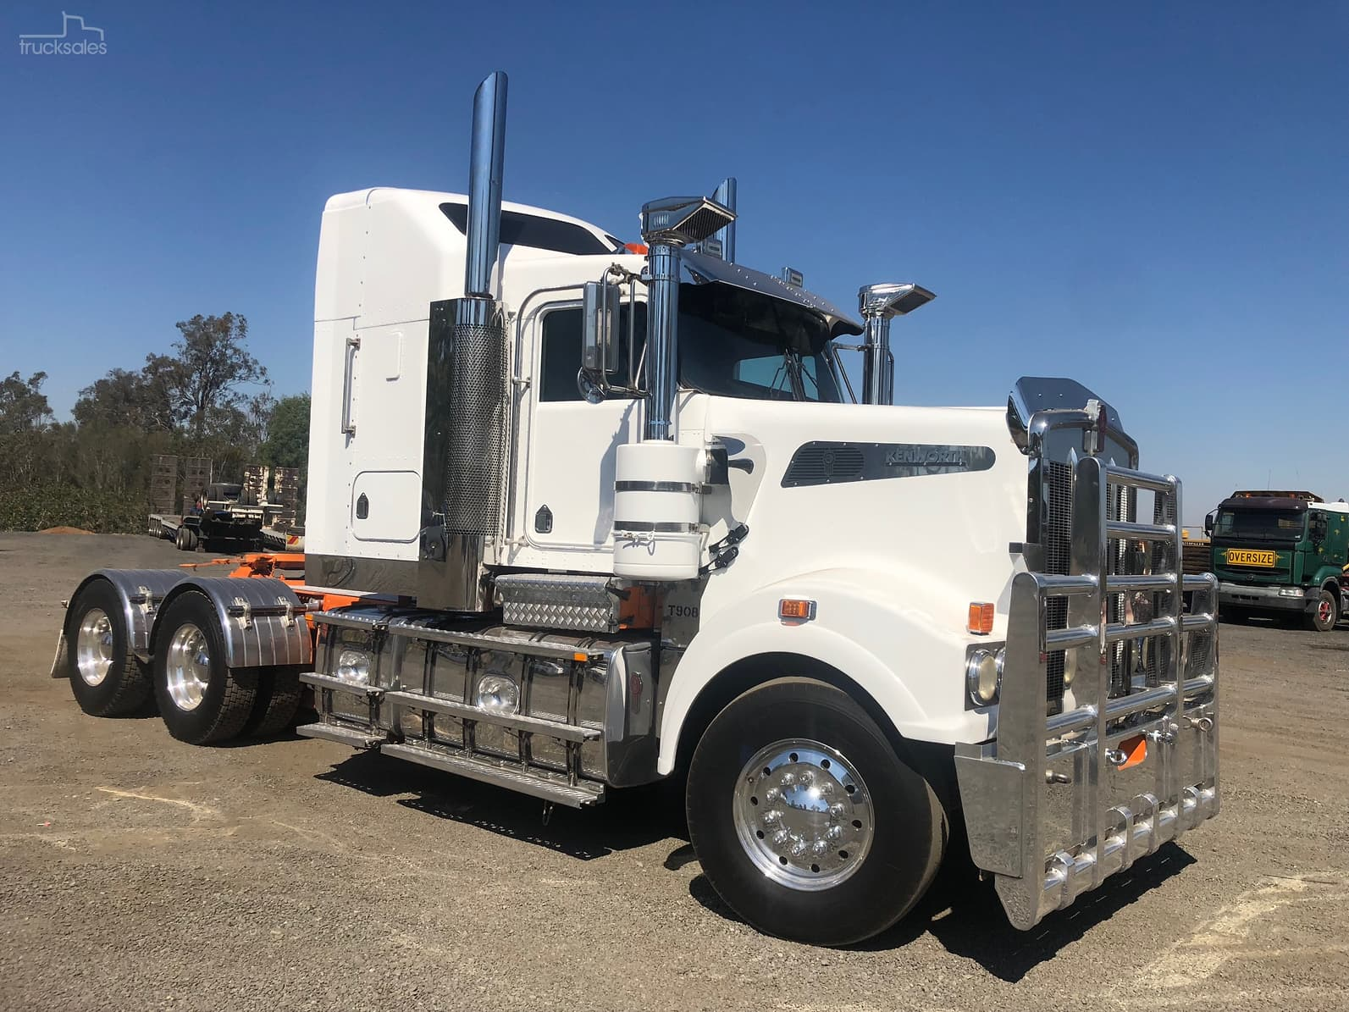
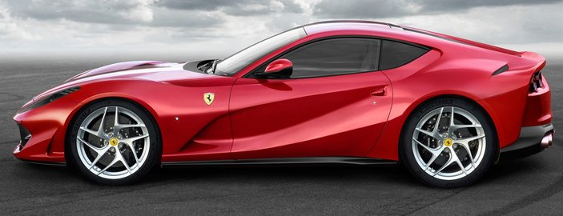

Slide 9
Being the “New Creation” we are –– HOLINESS
Do not be unequally yoked with unbelievers.... Be Separate.
“unequally yoked” is harnessing 2 different species together.
Disciples of Jesus are a different species to unbelievers. A new creation. Born again.
Before we were born again, we were children of the Devil. Now children of God.
Partnership; Fellowship; Accord; Portion; Agreement
sharing of common goals and activities
What partnership has righteousness with lawlessness?
A disciple’s goal: Worship; Grow in faith; Serve God; Obedience; Share Faith
What fellowship has light with darkness?
close union – brotherly bond
What accord has Christ with Belial?
harmony / agreement
Christ is diametrically opposed to other religions / spirituality / gods / mysticism
what portion does a believer share with an unbeliever?
Christians share a glorious future with Christ. Unbelievers await judgment.
What agreement has the temple of God with idols?
We are the Temple of God

Slide 10
Because God makes His home with us:
¹⁷ Therefore go out from their midst,
and be separate from them, says the Lord,
and touch no unclean thing;
then I will welcome you,
¹⁸ and I will be a father to you,
and you shall be sons and daughters to me,
says the Lord Almighty.”

Slide 11
Being the “New Creation” we are –– HOLINESS
Do not be unequally yoked with unbelievers.... Be Separate.
“unequally yoked” is harnessing 2 different species together.
Disciples of Jesus are a different species to unbelievers. A new creation. Born again.
Before we were born again, we were children of the Devil. Now children of God.
Partnership; Fellowship; Accord; Portion; Agreement
sharing of common goals and activities
What partnership has righteousness with lawlessness?
A disciple’s goal: Worship; Grow in faith; Serve God; Obedience; Share Faith
What fellowship has light with darkness?
close union – brotherly bond
What accord has Christ with Belial?
harmony / agreement
Christ is diametrically opposed to other religions / spirituality / gods / mysticism
what portion does a believer share with an unbeliever?
Christians share a glorious future with Christ. Unbelievers await judgment.
What agreement has the temple of God with idols?
We are the Temple of God

Slide 12
Because God makes His home with us:
¹⁷ Therefore go out from their midst,
and be separate from them, says the Lord,
and touch no unclean thing;
then I will welcome you,
¹⁸ and I will be a father to you,
and you shall be sons and daughters to me,
says the Lord Almighty.”
^{Matthew 9:10} And as Jesus reclined at table in the house, behold, many tax collectors and sinners came and were reclining with Jesus and his disciples. ¹¹ And when the Pharisees saw this, they said to his disciples, “Why does your teacher eat with tax collectors and sinners?” ¹² But when he heard it, he said, “Those who are well have no need of a physician, but those who are sick. ¹³ Go and learn what this means: ‘I desire mercy, and not sacrifice.’ For I came not to call the righteous, but sinners.”

Slide 13
Being the “New Creation” we are –– HOLINESS
Do not be unequally yoked with unbelievers.... Be Separate.
“unequally yoked” is harnessing 2 different species together.
Disciples of Jesus are a different species to unbelievers. A new creation. Born again.
Partnership; Fellowship; Accord; Portion; Agreement
sharing of common goals and activities
What partnership has righteousness with lawlessness?
A disciple’s goal: Worship; Grow in faith; Serve God; Obedience; Share Faith
What fellowship has light with darkness?
close union – brotherly bond
What accord has Christ with Belial?
harmony / agreement
Christ is diametrically opposed to other religions / spirituality / gods / mysticism
what portion does a believer share with an unbeliever?
Christians share a glorious future with Christ. Unbelievers await judgment.
What agreement has the temple of God with idols?
We are the Temple of God
“Separation” isn’t “isolation”
Don’t be tied to an unbeliever, but do be present.
marriage; business partnerships; employment contracts that limit expression of faith; very close friendships; other religions / spirituality; government commitments

